Slide 1

인공지능특론
(Advanced Artificial Intelligence)
2023
15주 합성곱 신경망과 활용
Hongsuk Yi
KISTI

Slide 2
합성곱 신경망 (Convolutional Neural Networks)

Slide 3
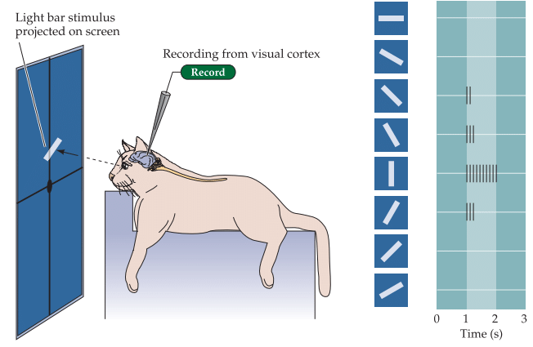
고양이의 시각피질
Hubel과 Wiesel은 시각피질의 세포들을 여러 유형으로 구별 (1959)

Slide 4

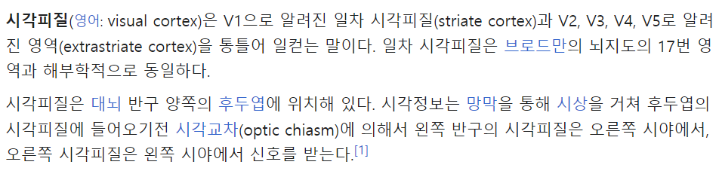
시각피질

Slide 5
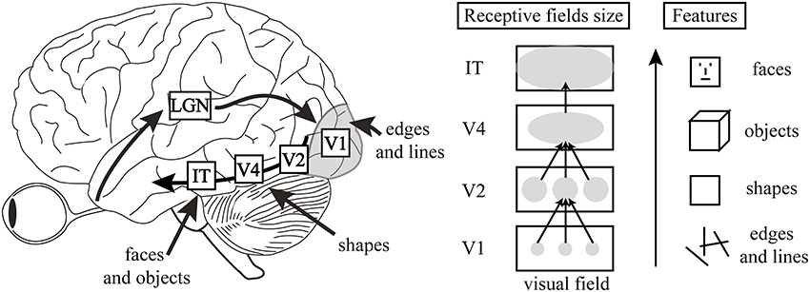
사람 뇌의 시각피질(visual cortex)
Human visual cortex is hierarchical
We want to learn higher level features by compositing lower-level features

Slide 6
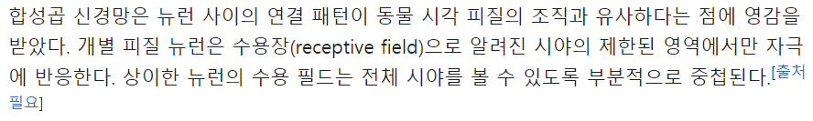
시각피질 아키텍처
합성곱 신경망으로 발전

Slide 7
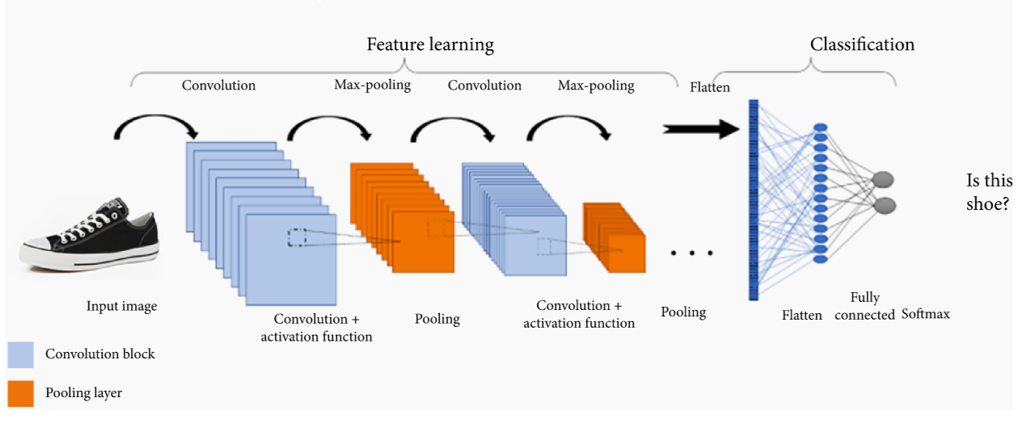
CNNs for Image Classification
source : https://www.hindawi.com/journals/wcmc/2022/7549397/fig2/

Slide 8
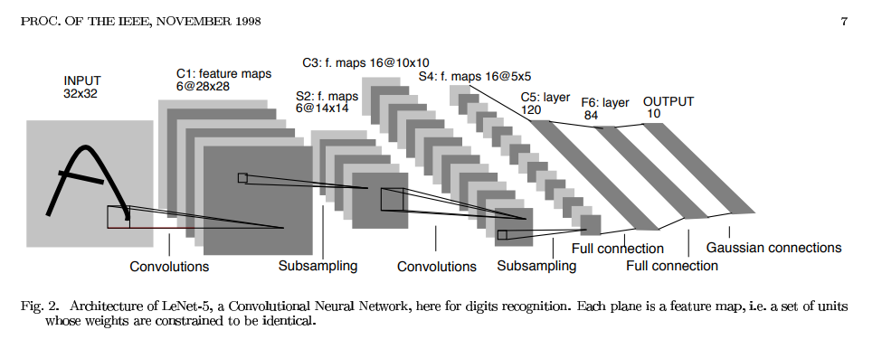
Convolutional Neural Networks

Slide 9
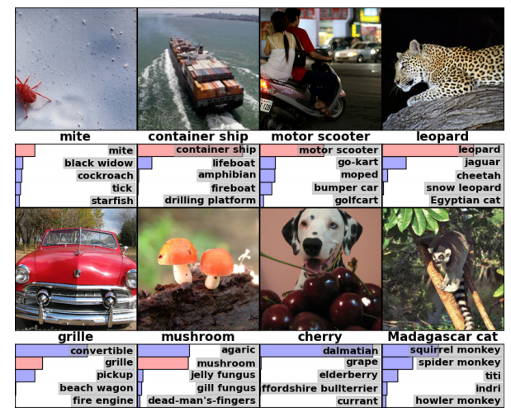
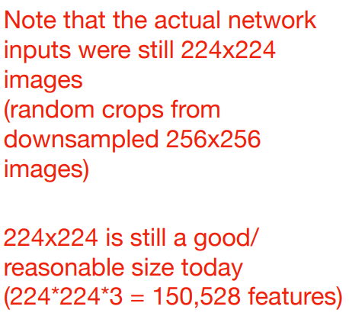
History of CNN and ILSVRC winners
The ImageNet set that was used has ~1.2 million images and 1000 classes
Accuracy is measured as top-5 performance:
Correct prediction if the true label matches one of the top 5 predictions of the model

Slide 10
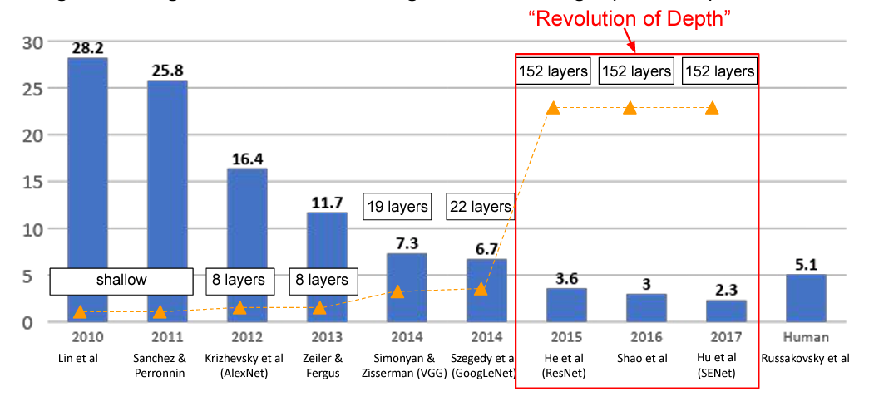
Main Breakthrough for CNNs: AlexNet & ImageNet
ImageNet Large Scale Visual Recognition Challenge (ILSVRC) winners
Human Error ~ 5.1%
source : https://pages.stat.wisc.edu/~sraschka/teaching/stat453-ss2021/

Slide 11
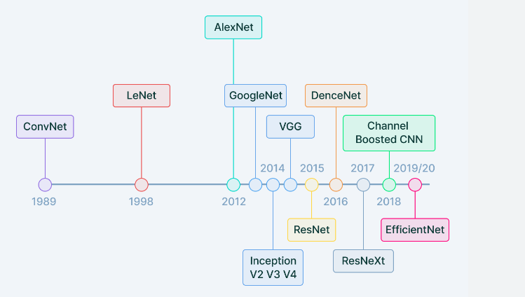
History of CNN
Figure source) https://www.v7labs.com/blog/convolutional-neural-networks-guide

Slide 12
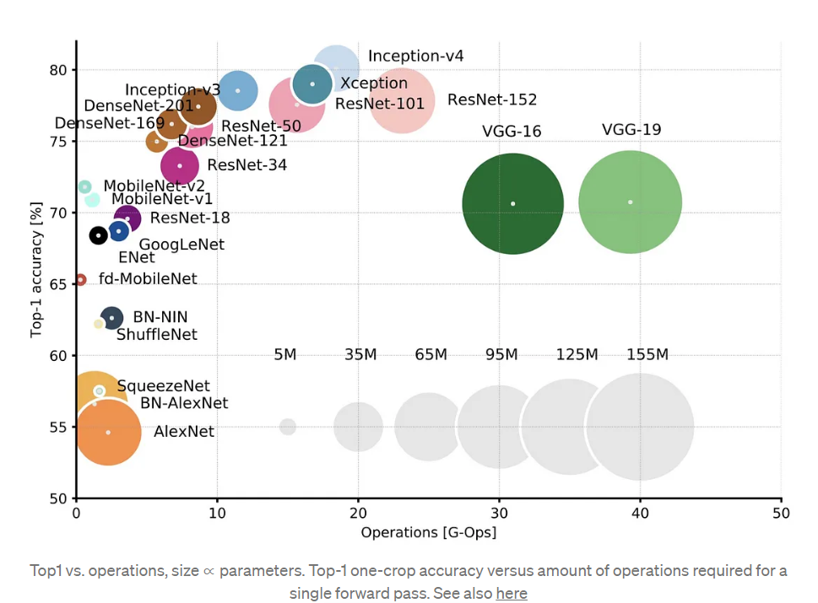
Common CNN Architectures

Slide 13
Common Applications of CNNs
source : https://pages.stat.wisc.edu/~sraschka/teaching/stat453-ss2021/

Slide 14
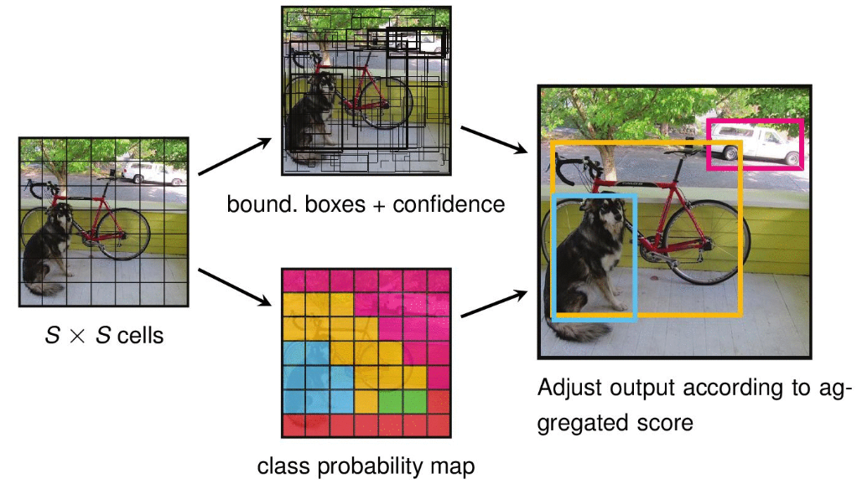
Object Detection and YOLO
You Only Look Once (YOLO) Algorithm
source : https://lme.tf.fau.de/lecture-notes/lecture-notes-dl/lecture-notes-in-deep-learning-segmentation-and-object-detection-part-4/

Slide 15
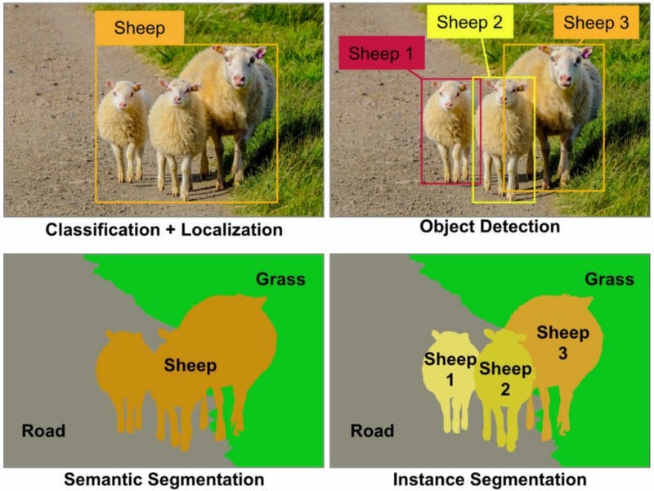
Object Segmentation
source https://nirmalamurali.medium.com/image-classification-vs-semantic-segmentation-vs-instance-segmentation-625c33a08d50

Slide 16
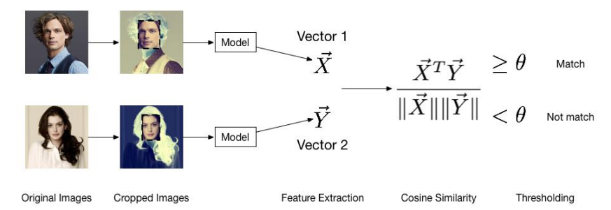
Face Recognition
source : https://arxiv.org/ftp/arxiv/papers/1910/1910.11563.pdf

Slide 17
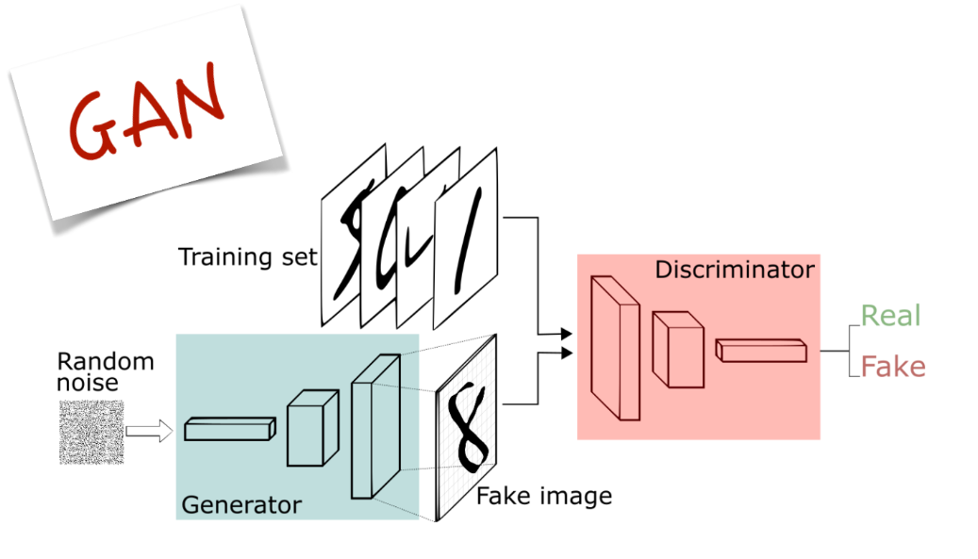
Image Synthesis : Generative Adversarial Networks
source : https://velog.io/@hwany/GAN

Slide 18
Why Computer Vision is (was) Hard: Challenges with Image Classification
source : https://pages.stat.wisc.edu/~sraschka/teaching/stat453-ss2021/

Slide 19
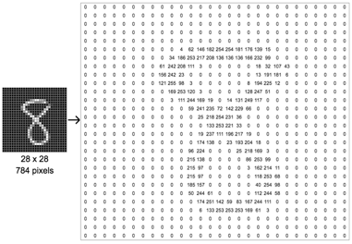
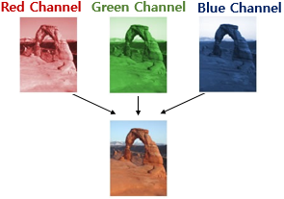
A computer sees an image as a matrix of numbers
Any real-world image pixels
Rows*columns*number of channels
Example number 8: 28*28*1 -> 784 pixels
Channel is Color
Channel : RGB
Value: 0~255
(source) https://wikidocs.net/64066

Slide 20
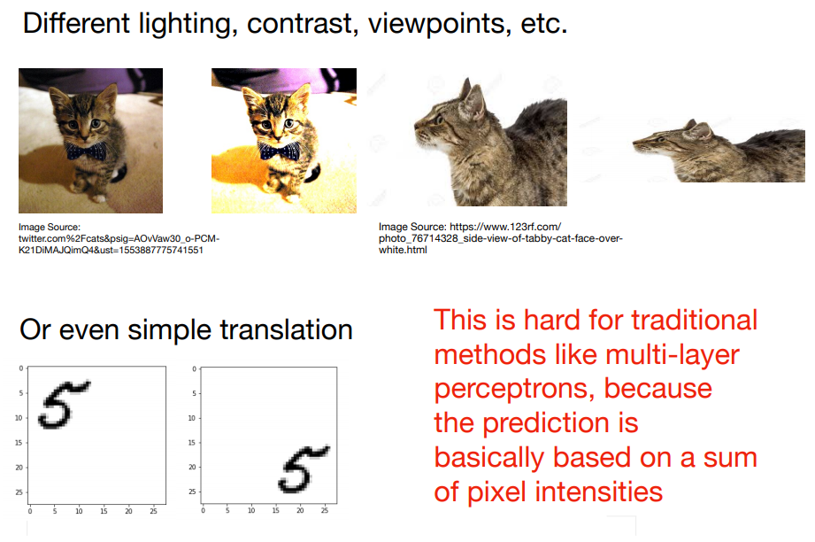
Why Image Classification is Hard
source : https://pages.stat.wisc.edu/~sraschka/teaching/stat453-ss2021/

Slide 21
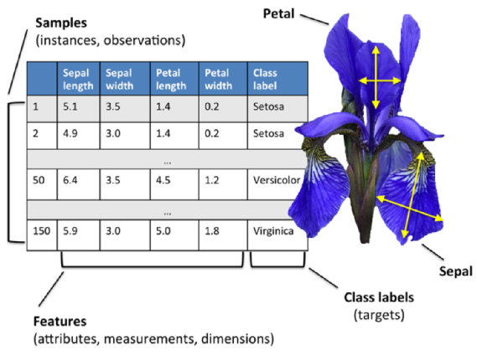
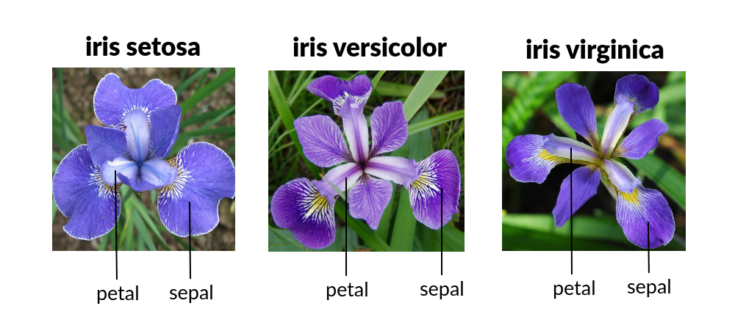
Traditional Approaches
Use hand-engineered features of Iris flower data set
source : https://www.bogotobogo.com/python/scikit-learn/scikit_machine_learning_features_extraction.php

Slide 22
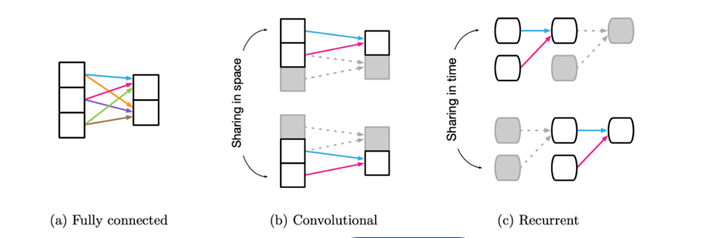
The Main Concepts Behind Convolutional Neural Networks
Definition of Relational inductive biases
Every machine learning model requires some type of architecture design and possibly some initial assumptions about the data we want to analyze. Generally, every building block and every belief that we make about the data is a form of inductive bias
Weak Relation
Locality
Sequential
source : https://www.baeldung.com/cs/ml-inductive-bias

Slide 23
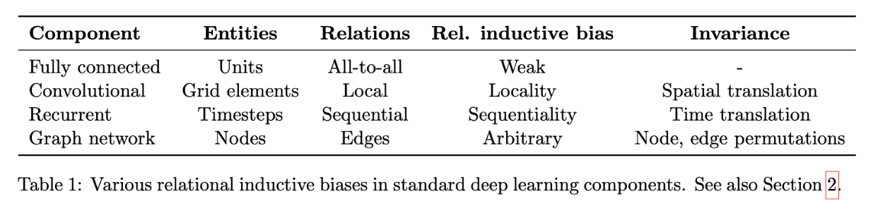
Relational inductive biases in deep learning
source : https://enfow.github.io/paper-review/graph-neural-network/2021/01/11/relational_inductive_biases_deep_learning_and_graph_netowrks/

Slide 24
Convolutional Neural Network Basics

Slide 25
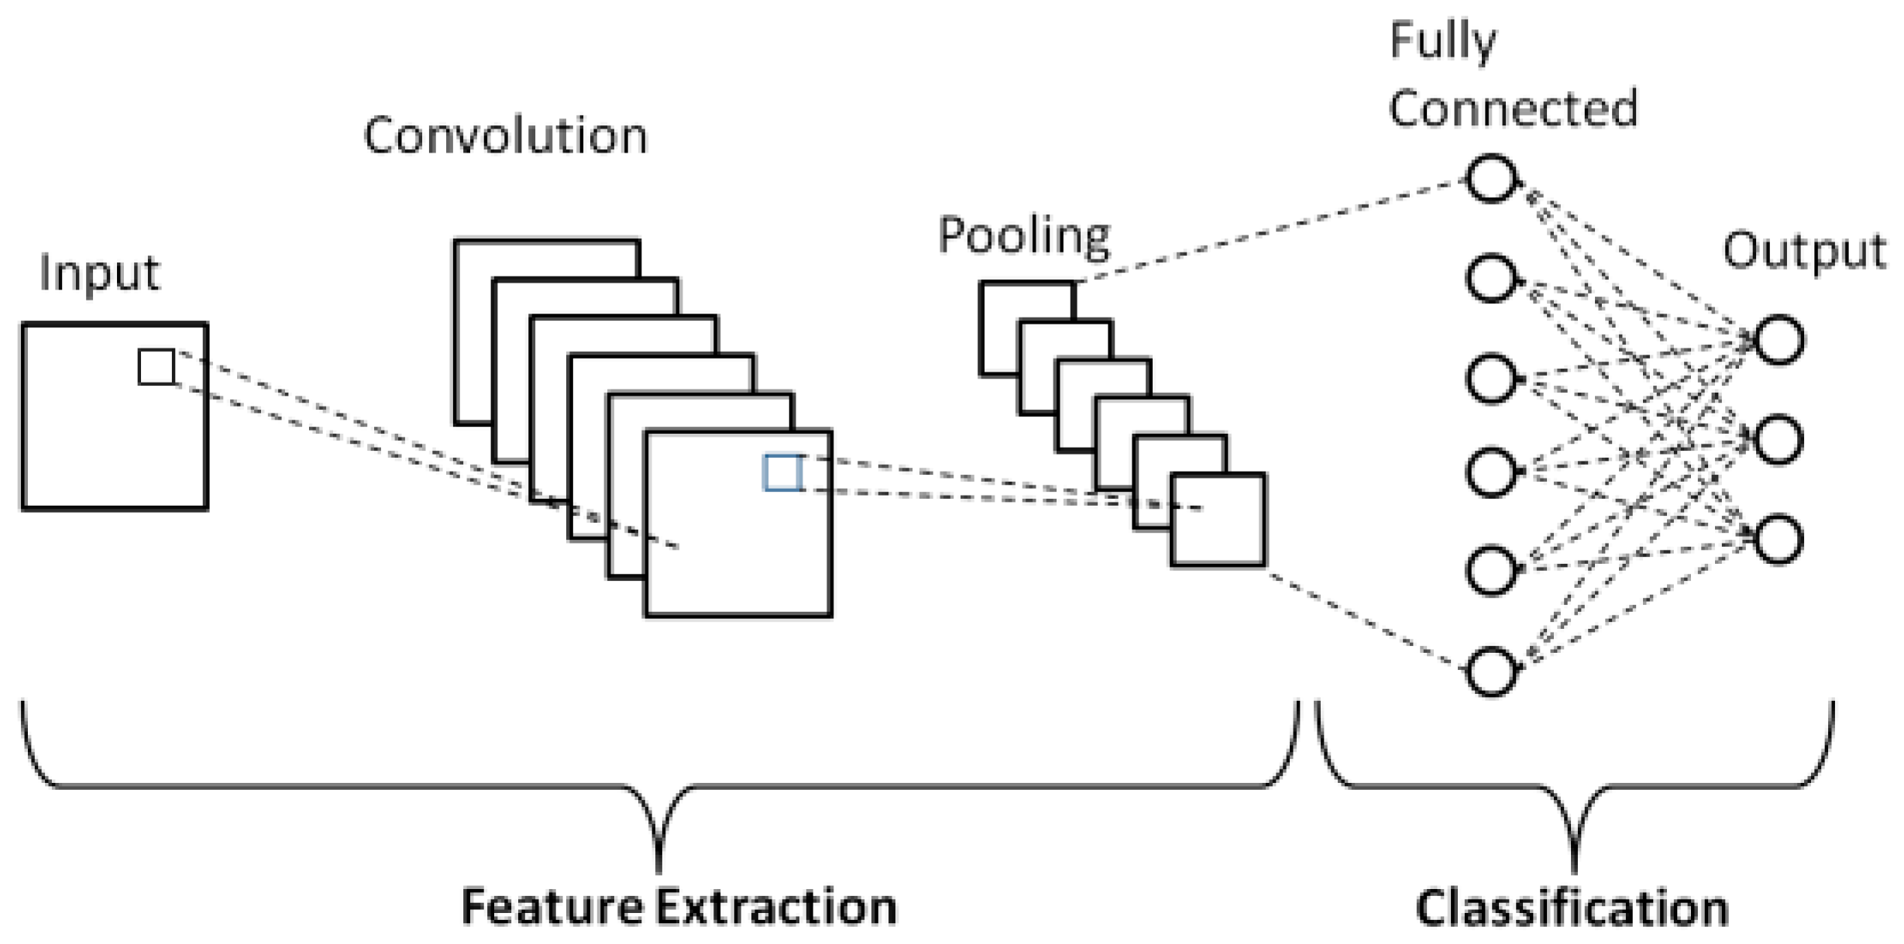
Schematic diagram of a basic CNN architecture
source : https://www.mdpi.com/2076-3417/9/21/4500

Slide 26
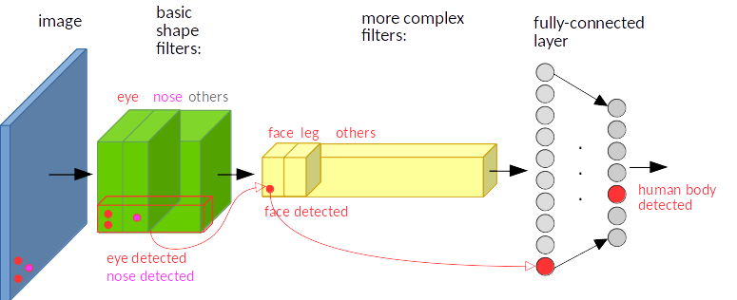
CNN Feature map

Slide 27
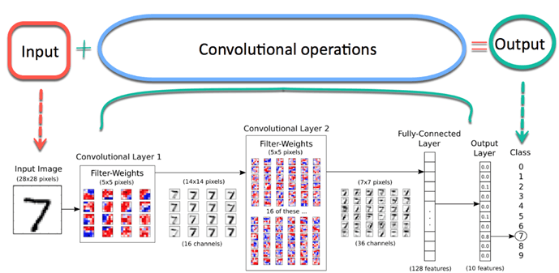
Architecture of a Convolutional Neural Network (CNN)
source : https://pages.stat.wisc.edu/~sraschka/teaching/stat453-ss2021/

Slide 28
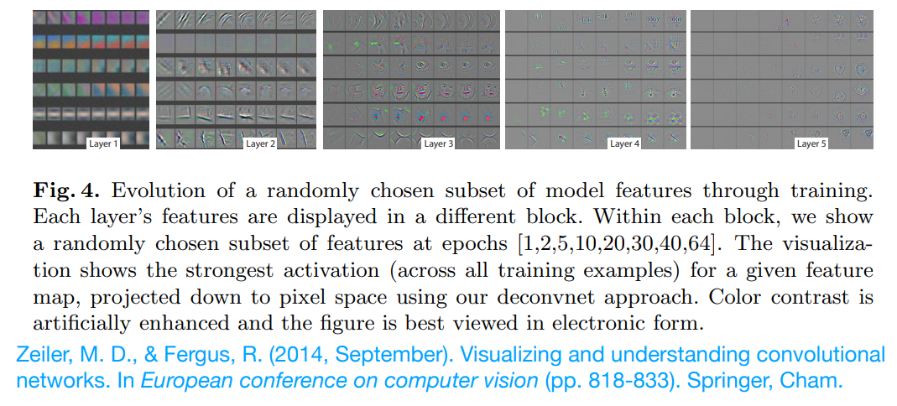
What a CNN Can See
Which patterns from the training set activate the feature map?
source : https://pages.stat.wisc.edu/~sraschka/teaching/stat453-ss2021/

Slide 29
Main Concepts Behind Convolutional Neural Networks
Local connectivity refers to images represented in a matrix of pixel values
we connect each neuron to only a patch of input data
A single element in the feature map is connected to only a small patch of pixels.
Parameter-sharing:
The same weights are used for different patches of the input image.
Many layers:
Combining extracted local patterns to global patterns
source : https://pages.stat.wisc.edu/~sraschka/teaching/stat453-ss2021/

Slide 30
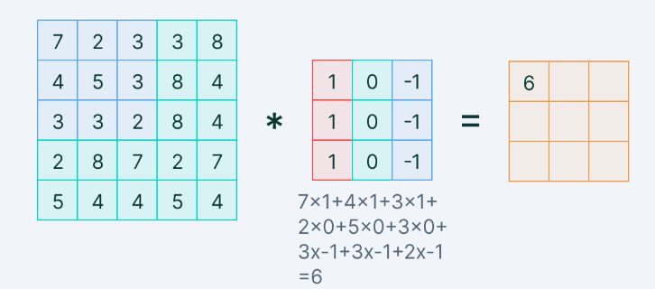
CNN works by comparing images piece by piece
Convolution Operation
Filters are spatially small along width and height
Element-wise multiplication between the filter-sized patch of the input image
And filter is done, which is then summed.
(source) https://www.oreilly.com/library/view/learning-tensorflow/9781491978504/ch04.html

Slide 31
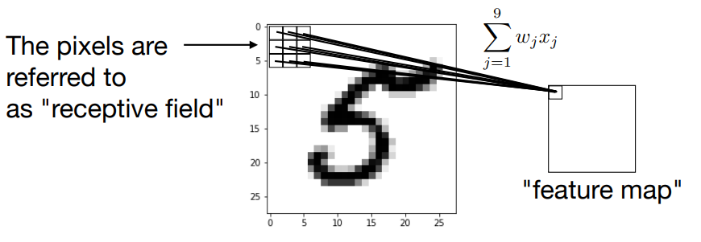
Weight Sharing
A "feature detector" (filter, kernel) slides over the inputs to generate a feature map
source : https://pages.stat.wisc.edu/~sraschka/teaching/stat453-ss2021/

Slide 32
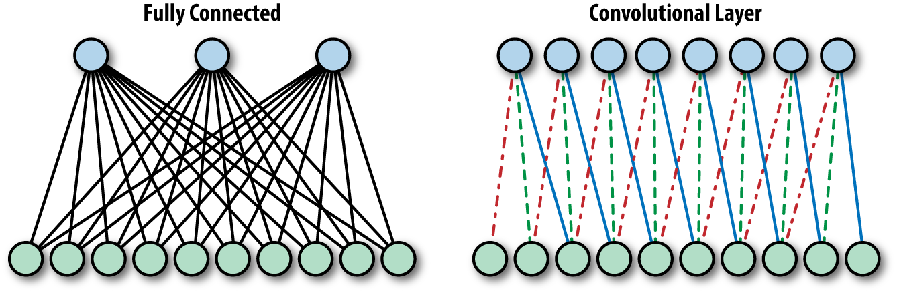
Fully-Connected layer vs Convnet
Fully-connected layer dealing with such a huge amount of parameters requires many neurons
it may lead to overfitting
CNN involves very few neurons with fewer parameters to scan an entire image
(source) https://www.oreilly.com/library/view/learning-tensorflow/9781491978504/ch04.html

Slide 33
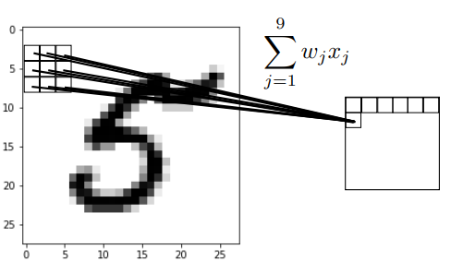
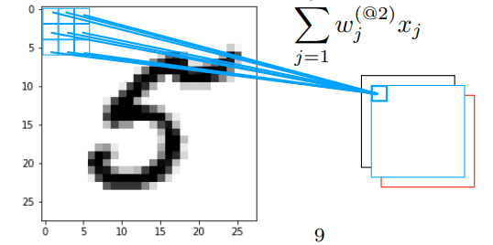
CNN: Weight Sharing
Multiple "feature detectors" (kernels) are used to create multiple feature maps
source : https://pages.stat.wisc.edu/~sraschka/teaching/stat453-ss2021/

Slide 34
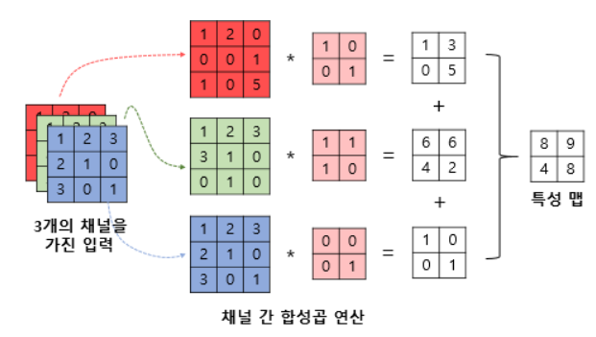
Convolutions with Color Channels
For multiple channels, the feature map does not contain RGB meanings
R
G
B
(source) https://wikidocs.net/64066

Slide 35
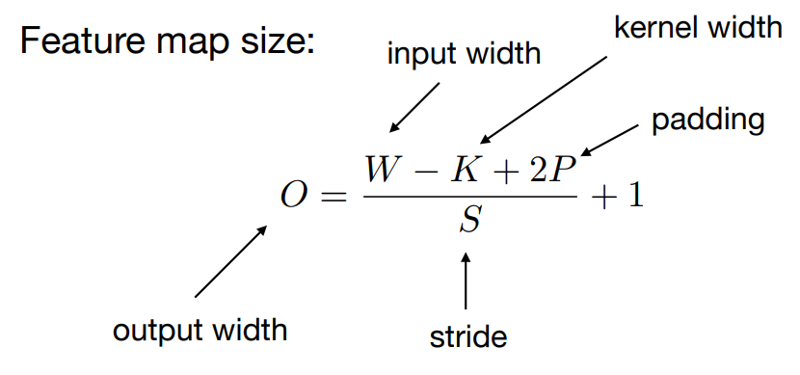
Feature map size: Size Before and After Convolutions
source : https://pages.stat.wisc.edu/~sraschka/teaching/stat453-ss2021/

Slide 36
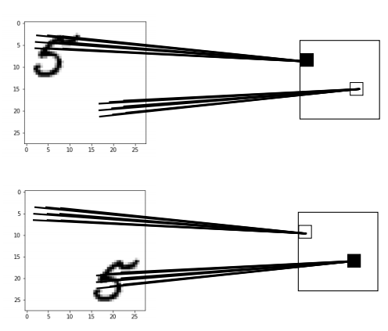
CNNs and Translation/Rotation/Scale Invariance
Note that CNNs are not really invariant to scale, rotation, translation, etc.
The activations are still dependent on the location, etc.
source : https://pages.stat.wisc.edu/~sraschka/teaching/stat453-ss2021/

Slide 37
Three hyperparameters in CNN
The depth
the number of filters we use to look for different features in the image.
Stride
The number of pixels we slide while matching the filter with the input image patch
Zero-padding
padding zeros around the border of the input image

Slide 38
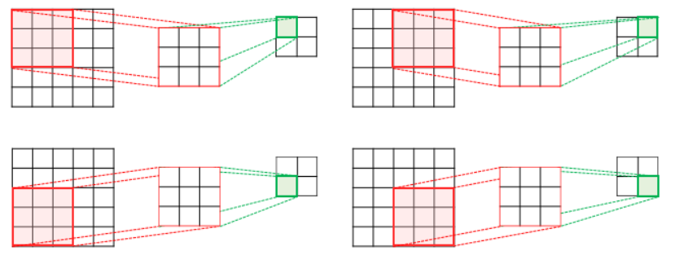
Strided Convolution
Straid is range of movement : Stride
5 × 5 input (spatially) assume 3x3 filter applied with stride, and finally 2x2 size feature map
(source) https://wikidocs.net/64066

Slide 39
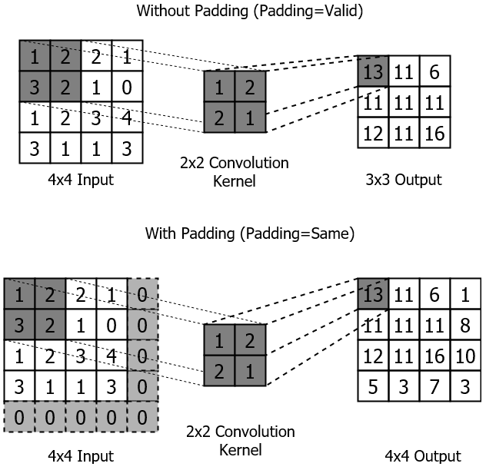
Padding basically extends the area of an image
Zero padding fills zero
padding=“valid”, padding=“same”
(source) https://livebook.manning.com/book/tensorflow-in-action/chapter-4/v-1/

Slide 40
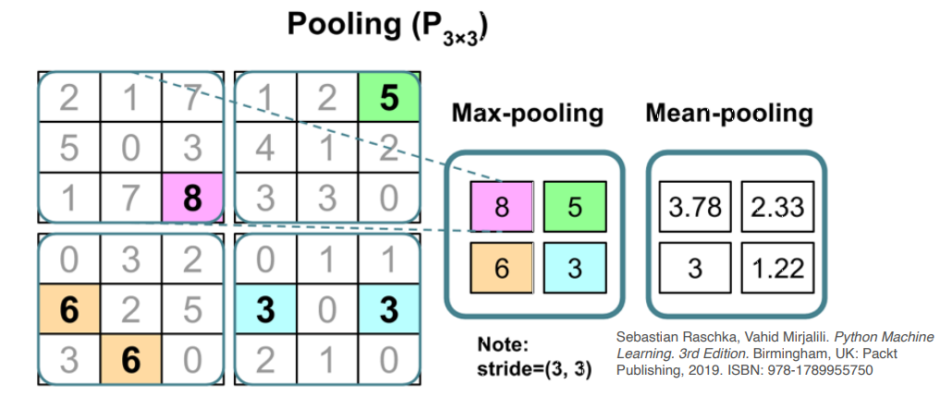
Pooling Layers Can Help With Local Invariance
Downside: Information is lost.
May not matter for classification, but applications where relative position is important (like face recognition)
In practice for CNNs: some image preprocessing still recommended
source : https://pages.stat.wisc.edu/~sraschka/teaching/stat453-ss2021/

Slide 41
1D CNN으로 교통흐름 예측하기 위한 전략

Slide 42
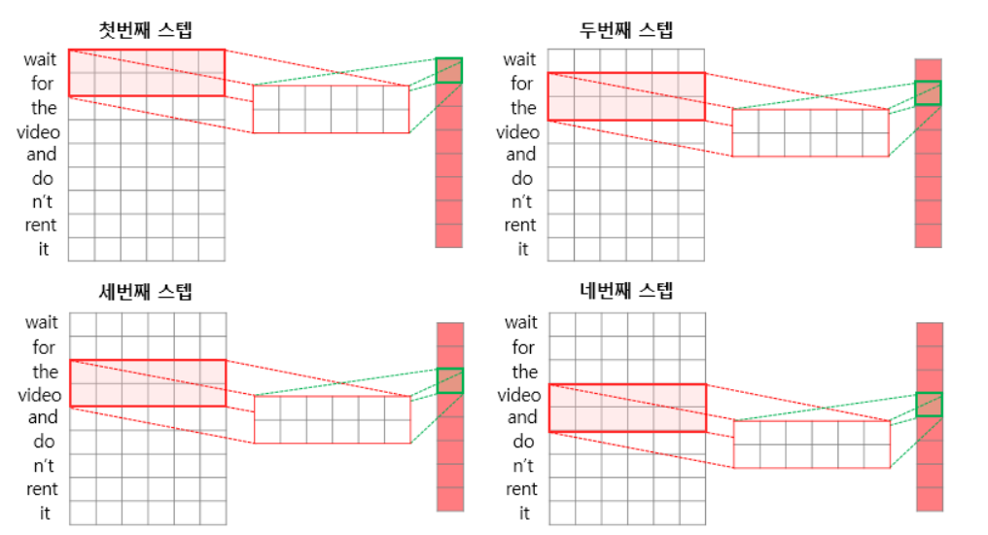
1차원 CNN
1차원 CNN 방법은 2차원과 달리
커널의 한 너비는 특성(feature)의 길이와 같이 둔다
커널의 높이가 1차원 CNN의 커널 크기가 된다.
아래 예제는 : the kernel size is 2

Slide 43
시계열 데이터 유형
1)
시계열 숫자 (10개의 look_back, 1개는 숫자)
X_train.shape = (10,000, 3, 1)
커널은 k=(3,1)
2)
시계열 이미지 (10개의 look_back, 3개는 RGB)
X_train.shape = (10,000, 10, 3)
3)
시계열 문장 (10개의 look_back, 512는 임베딩차원)
X_train.shape = (10,000, 10, 512)

Slide 44
시계열 데이터 유형
차량검지기 데이터의 경우
시계열 숫자
10개의 look_back
(예제)
X_train.shape = (배치, 시계열길이,특성)
특성(feature) = 1
시계열 Look_back = 10
커널 크기 k=3

Slide 45
시계열 데이터 유형
텍스트 데이터의 경우
시계열 숫자
10개의 look_back
단어 임베딩 길이
보통 256
X_train.shape = (배치, 시계열길이,특성)
X_train.shape=(10,000, 10, 256)
커널 크기 k=3
시계열 Look_back = 10
특성(feature) = 256

Slide 46
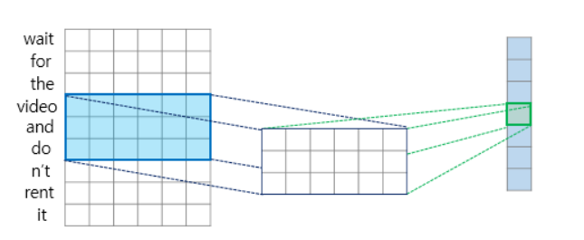
(예제) 1차원 CNN 단어
kernel size = 3
자연어 처리에서 참조되는 단어 묶음의 크기는 커널의 크기에 따라 다릅

Slide 47
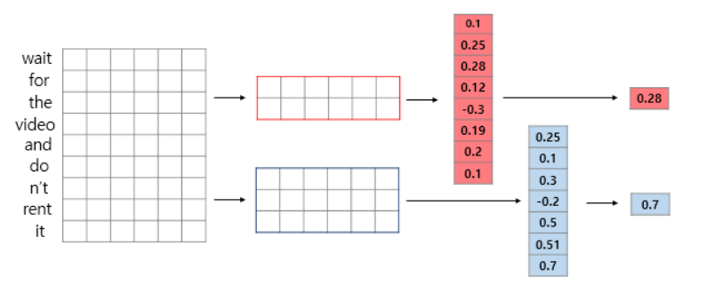
1D CNN에서 Max Pooling
Convolutional layer
(Convolution operation + activation function) followed by pooling layer on 1D CNN
max-pooling operation if the kernel size is 2 and 3,

Slide 48
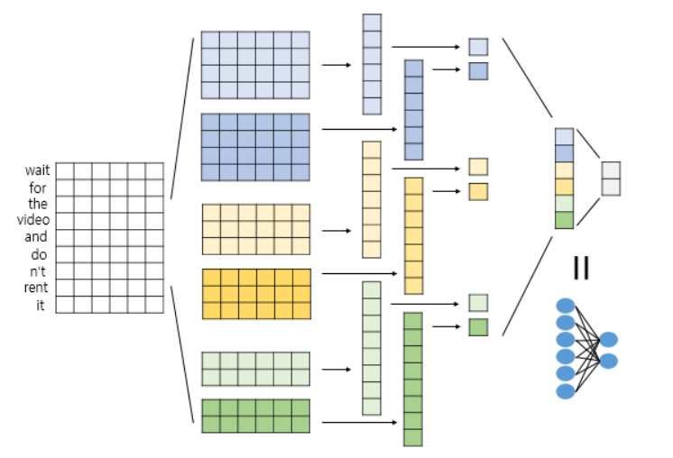
1D CNN Architecture : 문장 예시
6 poolings
6 poolings
6 kernels
1 FC layers
4x6
'wait for the video and do n't rent it’
Softmax for Classification
4x6
positive
negative
3x6
3x6
Input with word embedding
2x6
2x6

Slide 49
CNN으로 교통흐름 예측 실습 - VDS 데이터, CONV1D

Slide 50
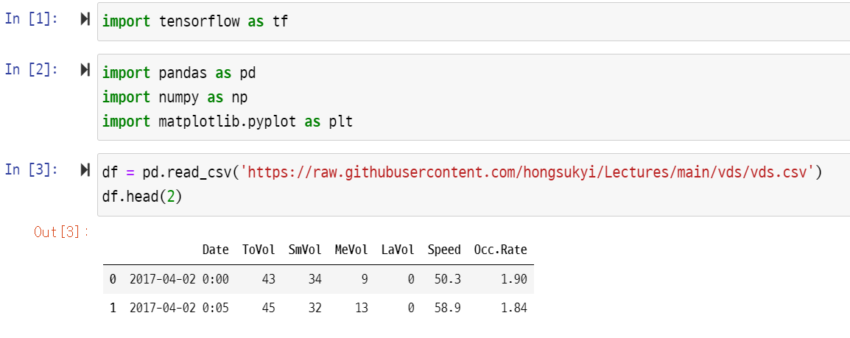
입력 데이터 다운로드

Slide 51
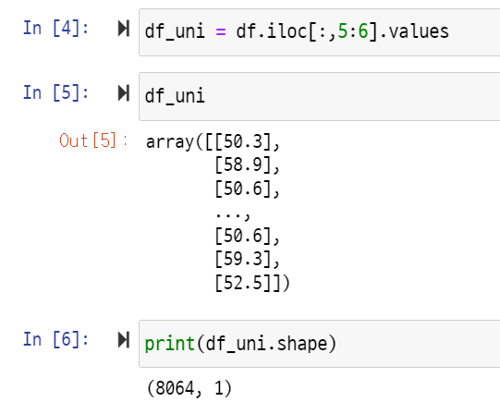
속도를 예측해보자

Slide 52
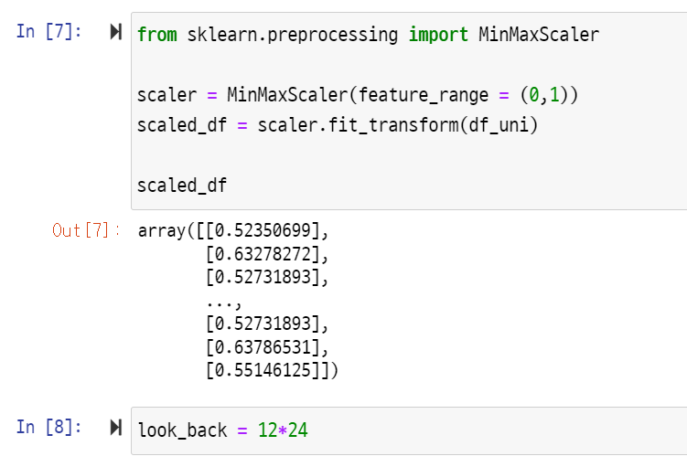
정규화 : Speed

Slide 53
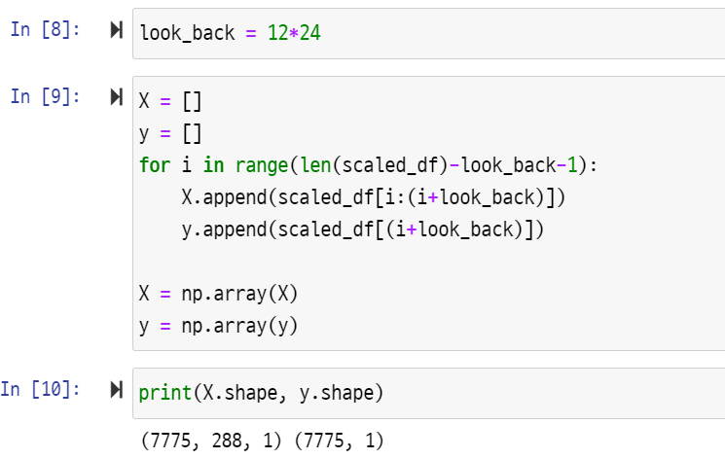
RNN 처럼 Conv1d를 위한 데이터 구조:

Slide 54
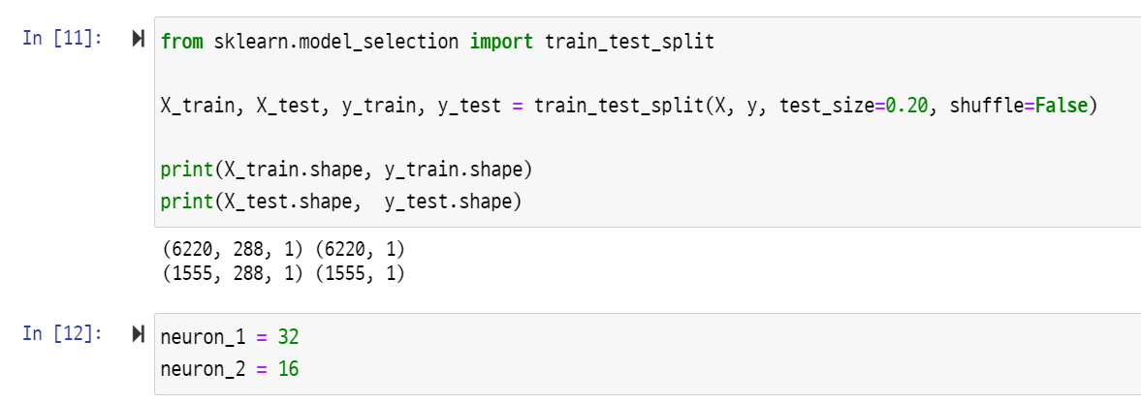
데이터 나누기

Slide 55
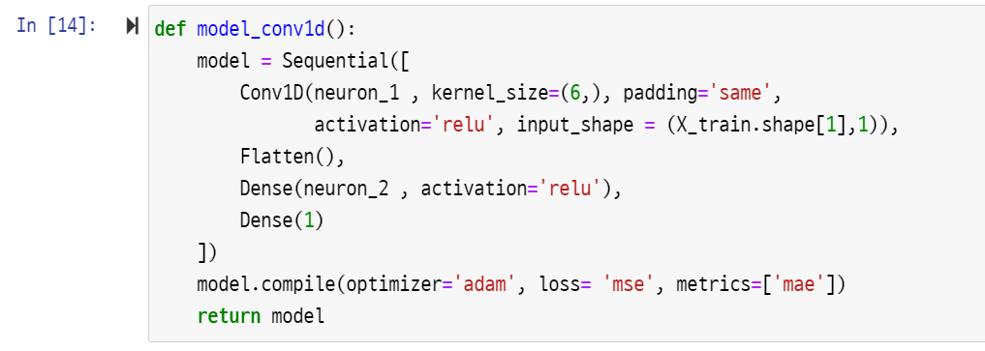
간단한 Conv1D 모델

Slide 56
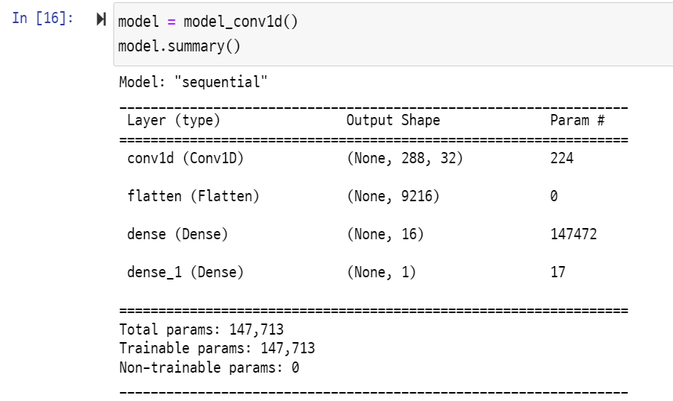
모델과 파라미터 개수

Slide 57
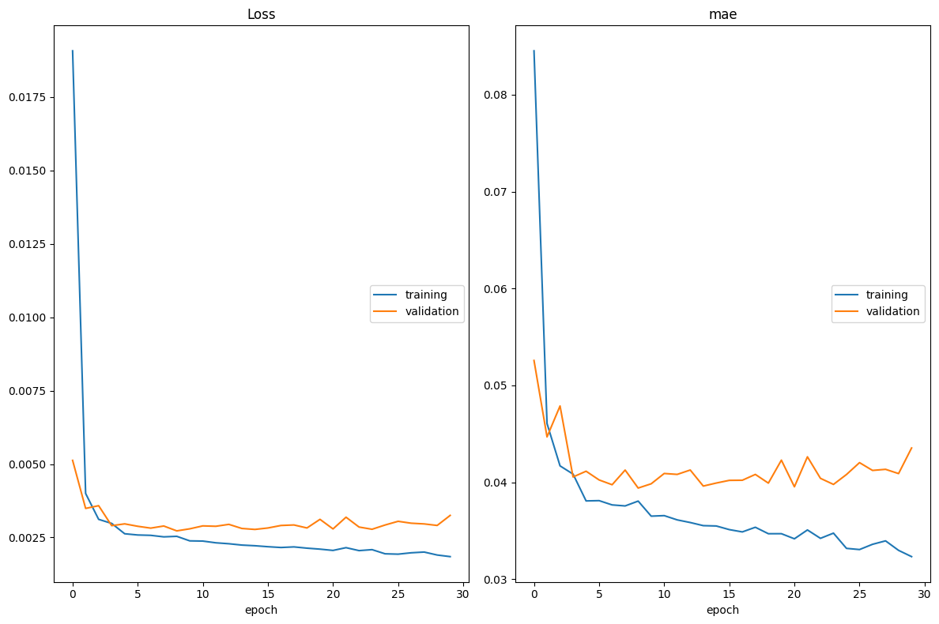
실시간 훈련 과정 가시화

Slide 58
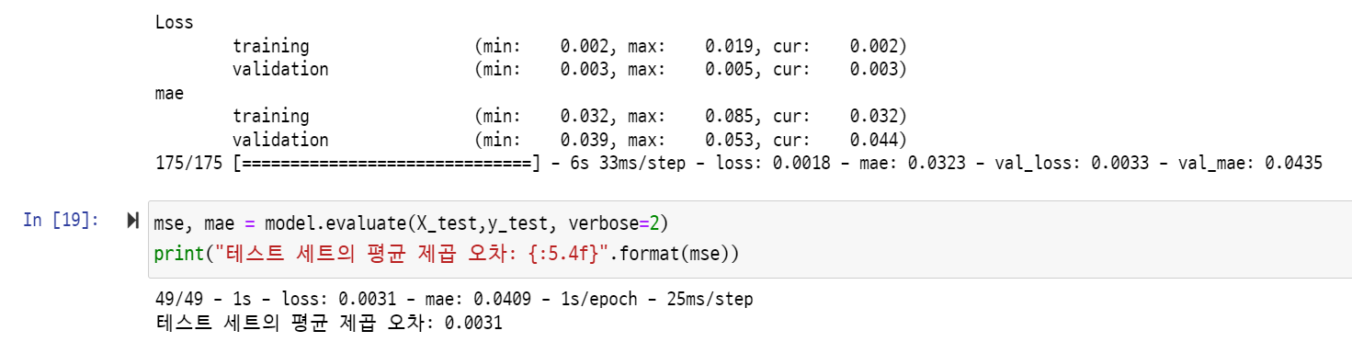
테스트 데이터로 MSE 결과

Slide 59

정규화된 속도 예측

Slide 60


실제와 예측을 비교 (정규화 값 사용)

Slide 61


실제값과 비교를 위한 데이터 환원

Slide 62

대전시 유성구 대학로 앞 도로에서 차량 속도(km/h) 예측

Slide 63

원래 값으로 환산 : 속도

Slide 64


실제와 예측

Slide 65

숙제
CNN 모델 최적화
속도(Speed)와 교통량에 대하여 아래 표를 작성하세요
Conv1d의 kernel_size 크기를 최적화 해보세요.
Look_back, 뉴런, 커널 사이즈 모두 변경 가능 (옵션)
가장 작은 MSE 값을 제출함
항목 | Look_back(5시간) | 뉴런1=뉴런2 | Kernel_size | MSE
Speed | 60 | 32 | 3 | ?
Speed | 60 | 32 | ? | ?
Speed | 60 | 32 | ? | ?
Speed | 60 | 32 | ? | ?
Speed | ? | ? | ? | ?

Slide 66

TRUST
2023
KISTI
Korea Institute of Science
and Technology Information

